Slide 1

Lambton College, Toronto
CBD 2214 2 Big Data Fundamentals - Data Storage Networking
Professor:- Graham Wall
Subject: Assignment 1
Group Details:
Akshar Chaklashiya (350)
Ankit Baranwal (111)
Bharat Vora (032)
Naman Shah (267)

Slide 2

Dataset
Source: UCI Dataset (Link)
Rental bikes are currently being offered in several big locations to improve transportation comfort. It is critical to have the rental bike ready and accessible to the public at the appropriate moment since this reduces the amount of time people must wait.
The most important component in predicting the number of rental bikes needed at each hour is in order to maintain a steady supply.

Slide 3

What we’re predicting?
We are predicting the rental number of bikes in this assignment using other attributes of the dataset.
So, basically the bikes numbers are depending on the various attributes (like weather conditions and the time of the year, and many more).
We are using this regression problem and applying the Random Forest regressor algorithm

Slide 4

Attributes
Date: year-month-day
Rented Bike count - Count of bikes rented at each hour
Hour - Hour of the day
Temperature-Temperature in Celsius
Humidity - %
Windspeed - m/s
Visibility - 10m
Dew point temperature – Celsius
Solar radiation - MJ/m2
Rainfall – mm
Snowfall – cm
Seasons - Winter, Spring, Summer, Autumn
Holiday - Holiday/No holiday
Functional Day - NoFunc (Non Functional Hours), Fun(Functional hours)

Slide 5
Random Forest Classifier
Algorithm Used
Supervised Learning

Slide 6

What is the Algorithm?
The Random Forest algorithm gives more accurate predictions than most other machine learning algorithms. Decision tree learning is one application. Decision trees create forests.
Each decision tree is an independent classifier. A forest of solid classifiers is created by using these decision trees. This forest of robust classifiers gives a better prediction than decision trees or other machine learning algorithms.

Slide 7

Algorithm’s
Advantages
Disadvantages
Most non-linear classifiers are not as accurate as of the random forest algorithm.
It uses multiple decision trees to come to its conclusion, so it is also highly robust.
A random forest classifier does not have overfitting problems since it takes the average of all predictions, cancelling out biases and thus fixing the problem.
Using multiple decision trees to make predictions, this algorithm is significantly slower than other classification algorithms.
For a random forest classifier to predict, every tree in the forest must predict the same input and vote on it. This can take a long time.
The slow pace of random forest classifiers makes them unsuitable for real-time prediction.

Slide 8
Accuracy

Slide 9

Why Random Forest?
Because of its simplicity and excellent accuracy, random forest is one of the most used algorithms for regression problems (i.e., predicting continuous outcomes).

Slide 10
Extremely great precision
Random Forest regression yields extraordinarily high accuracies thanks to its 'wisdom of the crowds' technique.
Simple to work with
Because random forest can deal with both category and numerical input variables, we need to spend less time encoding or classifying data one at a time. It is unaffected by missing data and can deal with outliers to some extent. Overall, it saves you time that would otherwise be spent cleaning data, which is typically the most time-consuming part of any data science process.

Slide 11
Interpretation
Random forests have been assessed to output the decision trees that were utilized in the final decision; however, it is not as clearly understandable as its fundamental algorithm decision tree regression. The separate trees may be utilized to figure out what the key decision nodes were, as well as to raise inquiries about how the final estimate came to be.
Scales well
Computationally, the algorithm scales well when new features or samples are added to the dataset.

Slide 12
Data Pre-processing
Variable Exploring and Cleaning
In the Seasons column, there are four season categories i.e., Winter, Spring, Summer, and Autumn. We assign category codes to convert this string data into numerical data for fitting into the regressor.
In the same way, we have converted the columns of ‘Functional Day’ and ‘Holiday’ attributes to numerical data from categories in string form.
The ‘date’ column would not be a suitable parameter for use in the regressor algorithm. Therefore, we dropped the ‘date’ attribute.
Checking for null values and duplicate entries in the dataset. But we haven’t found any null values or duplicates entries in the data.

Slide 13
Splitting the data for training and testing
Using 85 % data for training and 15 % for testing.

Slide 14
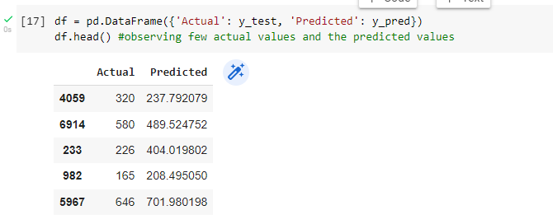
Applying the Random Forest Algorithm
Using Random Forest Regressor from sklearn ensemble library in Python. Setting the number of estimators to 101. n_estimators address the number of trees in the woodland. Generally, the higher the number of trees the better to become familiar with the information.
Output

Slide 15
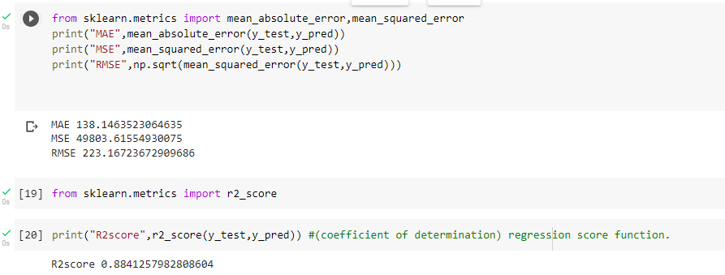
Evaluating the trained model
We observe that the predicted values from the trained model aren’t exactly very close to the actual values, with all the predicted values having an average difference of about 100 cycles to the actual numbers.
Evaluating the trained model of Random forest regressor:

Slide 16
Metrics for evaluation
R2Score
Mean absolute error
R2 (coefficient of determination) regression score function. The best possible score is 1.0 and it can be negative (because the model can be arbitrarily worse). A constant model that always predicts the expected value of y, disregarding the input features, would get an R2 score of 0.0.
In our observation, we get an R2 score of 0.884.
Mean absolute error is a measure of errors between paired observations expressing the same phenomenon. Examples of Y versus X include comparisons of predicted versus observed, subsequent time versus initial time, and one technique of measurement versus an alternative technique of measurement.
In our observation, we get a mean absolute error of 138.14

Slide 17
Metrics for evaluation
Mean squared error
Root Mean Square Error (RMSE)
Mean squared error or mean squared deviation of an estimator measures the average of the squares of the errors—that is, the average squared difference between the estimated values and the actual value. MSE is a risk function, corresponding to the expected value of the squared error loss.
In our observation, we get a mean absolute error of 49803.61
Root Mean Square Error (RMSE) is the standard deviation of the residuals (prediction errors). Residuals are a measure of how far from the regression line data points are; RMSE is a measure of how to spread out these residuals are. In other words, it tells you how concentrated the data is around the line of best fit.
In our observation, we get a mean absolute error of 223.16

Slide 18


Reference
Introduction to Random Forest in Machine Learning
Section.in
A Complete Guide to the Random Forest Algorithm
Built In

Slide 19

Conclusion
Random forests are also very hard to beat performance wise. Of course, you can probably always find a model that can perform better, like a neural network for example, but these usually take more time to develop, though they can handle a lot of different feature types, like binary, categorical and numerical.
Overall, random forest is a (mostly) fast, simple and flexible tool, but not without some limitations.

Slide 20
Thank you.

